Slide 1
Developing Systems Thinking Information Systems in Organizational Design and Applied Systems Thinking
Barbaros Özcan
March, 2017 – METU II
Notes:
Hi everyone, today i will talk about Developing Systems Thinking. I will introduce you techniques/diagrams for describing and visualizing systems.

Slide 2
Agenda
Interrelatedness of things
Diagramming techniques
Organization charts
System maps
Spray diagram
Influence and causal diagrams
Flowcharts
Decision sequence diagram
Flow block diagrams
Event flow diagrams
Data flow diagrams
Rich pictures
System description and analysis stages
Systems thinking in action

Slide 3

Interrelatedness of things
https://youtu.be/17BP9n6g1F0

Slide 4
Diagramming techniques
Diagramming techniques are essential to good systems practice
Require the analyst to think clearly about the topic of interest
Form a permanent record of the analyst’s thoughts on the subject at the time, and are useful for future reference
Facilitate communication of information between the analyst and others

Slide 5
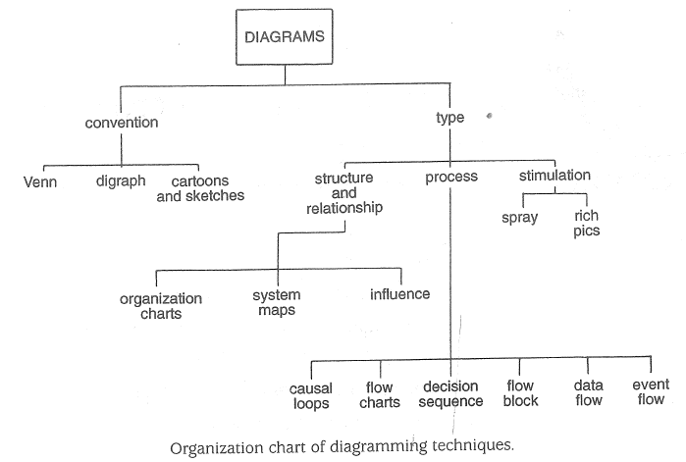
Diagramming techniques

Slide 6
Organization charts
Introduce two concepts in systems work
The concept of relationship
Hierarchies in relationships

Slide 7
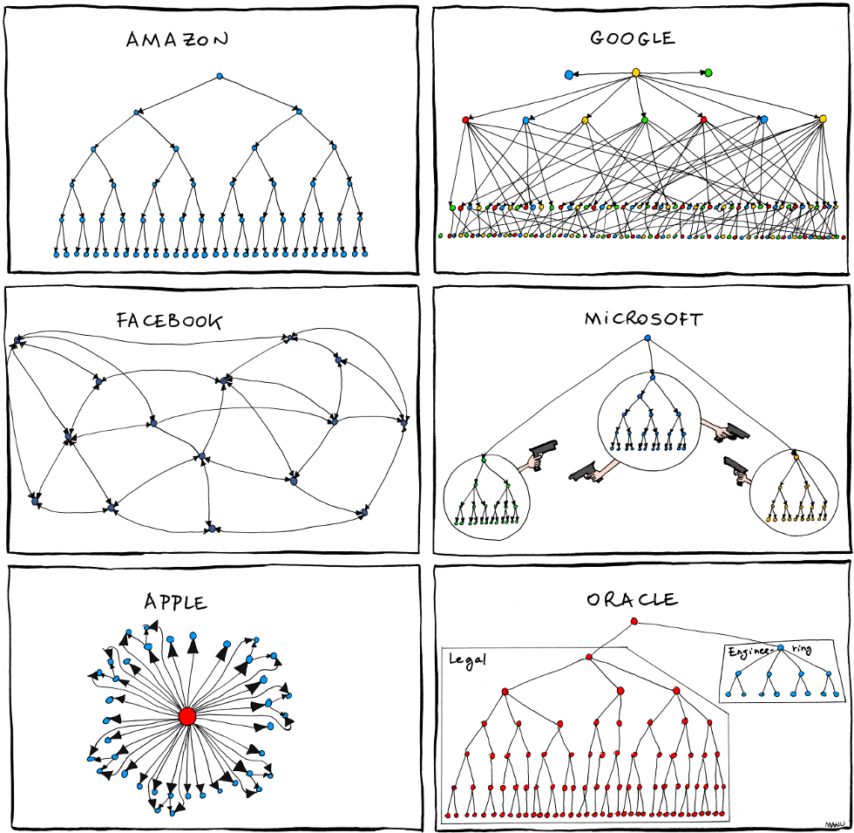
Organization charts

Slide 8
System maps
Often drawn according to the Venn convention
Convention is consistent with the theory of “sets” whereby
sets of like components are bound together and
boundaries overlap where some properties of two or more sets are shared

Slide 9
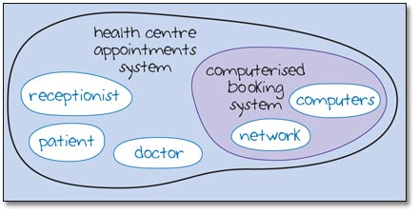
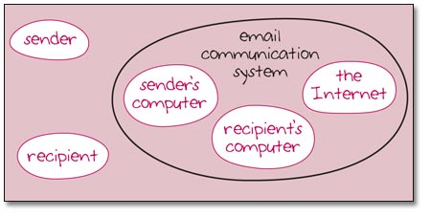
System maps

Slide 10
Spray diagram
A thinking/brainstorming tool
Useful for loosening up thinking in the early stages of problem solving or analysis
In the early stages, the analyst’s thinking is dogged by partial images of the problem and of possible solutions based on past experience
Tries to break out of serial, “vertical” ap­proach by forcing an expansion of thought, i.e. “lateral thinking”
Alternate expansion and contraction of focus is a common feature
Notes:
İncreases creativity

Slide 11
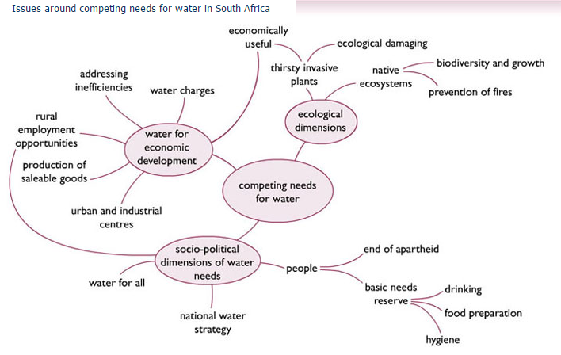
Spray diagram

Slide 12
Influence and causal diagrams
The lines between components show only that a relationship exists but indicate nothing about the direction of influence
Arrowheads can be used to indicate direction of influence
Double-headed arrows indicate mutual influence

Slide 13
Influence and causal diagrams
Influence means that one component affects another but that does not necessarily mean that a causal relationship exists between them
A person’s height influences her weight but weight is not caused by height

Slide 14
Influence and causal diagrams
Causal diagrams are used where evidence suggests a causal process
An increase in accident prevention activity causes a reduction in the number of accidents
The sign in the middle of the loop indicates control, and the arrow shows the direction
The net effect of the causal loop is the tendency to control
+, -, Reinforce or Balance

Slide 15
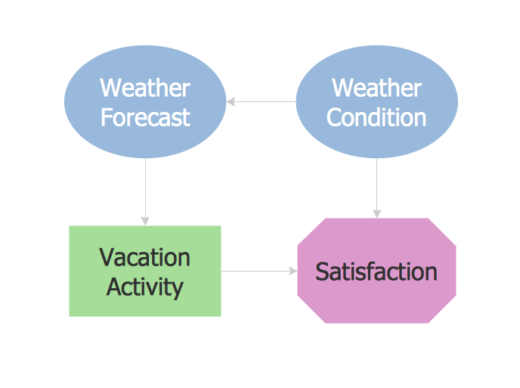
Influence and causal diagrams

Slide 16
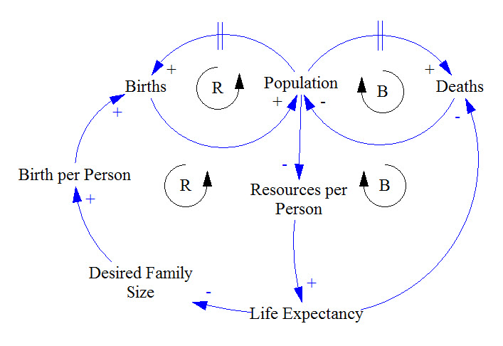
Influence and causal diagrams
Population Model with Resource Constraints

Slide 17
Flowcharts
A summary means for expressing any well-defined set of operations for carrying out a task
Called an algorithm, which could be expressed solely in words but is easier to follow in flow chart format

Slide 18
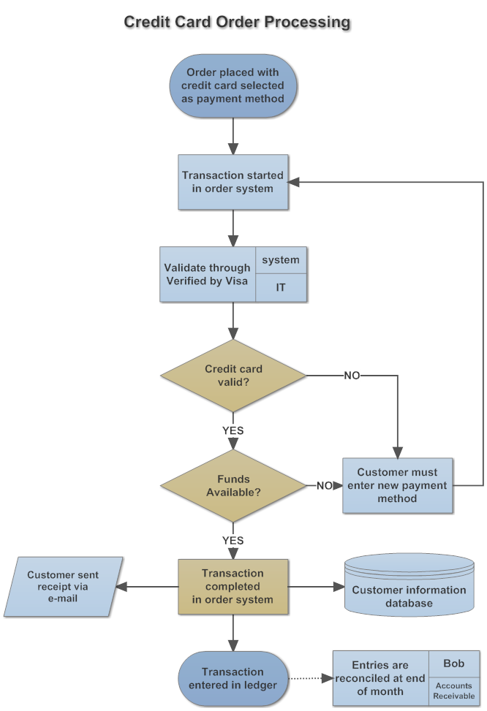
Flowcharts

Slide 19
Decision sequence diagram
A special kind of flow chart which relates to rational decision-making
The contents of each box or blob relate to choices or decisions, and the connections between them represent either a logical sequence and/or actions

Slide 20
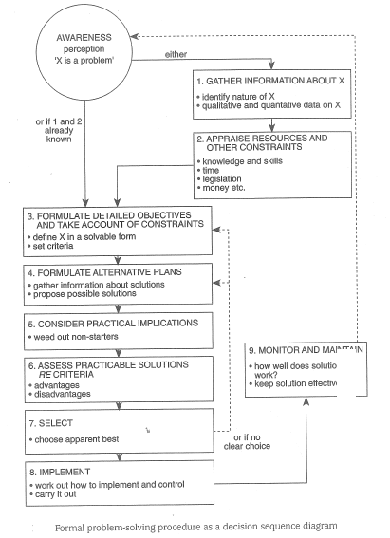
Decision sequence diagram

Slide 21
Flow block diagrams
Flow charts which depict blocks of actions in a practical procedure for doing something
Resource input requirements are identified at relevant blocks

Slide 22
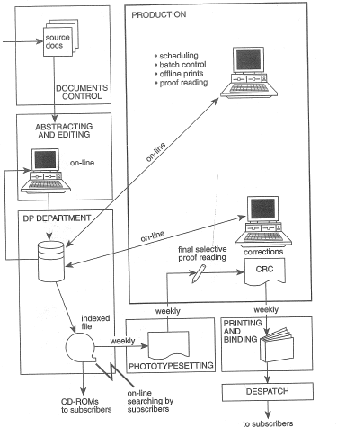
Flow block diagrams

Slide 23
Event flow diagrams
Shows the flow of events over time
Useful in systems analysis for
summarizing the sequence of events leading to the current position and
how the latter relates to projected future developments

Slide 24
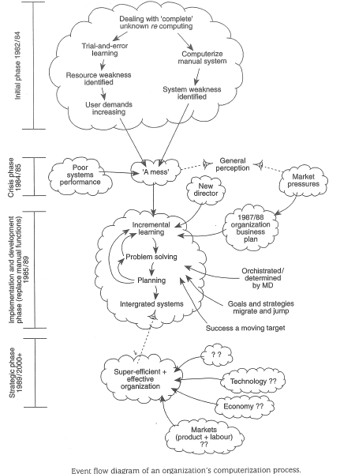
Event flow diagrams

Slide 25
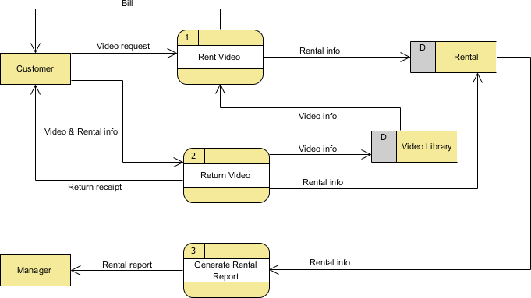
Data flow diagrams
Depict the flow of information in an infor­mation system

Slide 26
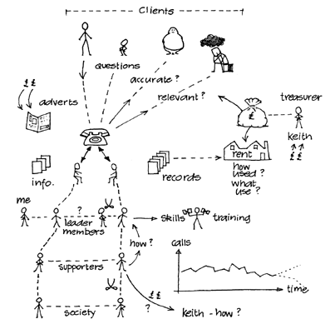
Rich pictures
Visual summary of complexity in a situation

Slide 27
System description and analysis stages
System description is an analytical framework which enables to identify some key sys­tems for detailed analysis
Analysis stages
Awareness/consciousness of problems/issues
Commitment
Testing of whether analysis is warranted
Separation of a few relevant systems
Selection of one or two key systems
Detailed analysis and full description

Slide 28
System description and analysis stages
Awareness/consciousness of problems/issues
Listing topics
Constructing a spray diagram
Drawing a rich picture
Commitment
Commitment statements
The essence of what someone in their role would be committed to
Notes:
Assigned tasks

Slide 29
System description and analysis stages
Testing of whether analysis is warranted
Will success be recognizable?
Is analysis the most effective way of getting results?
Would analysis be purposeful or simply be indulging someone’s idle curiosity?
Is the client’s or problem owner’s goal important enough to warrant systems analysis?
Positive answers to each of these questions

Slide 30
System description and analysis stages
Separation of a few relevant systems
Teasing out areas of concern from the successful commitment statement(s)
Selection of one or two key systems
Selection for detailed analysis

Slide 31
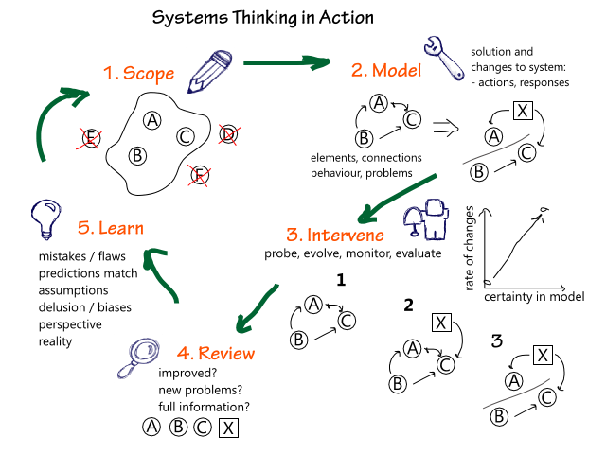
Systems thinking in action

Slide 32
References
Waring, A. (1996). Practical Systems Thinking, International Thomson Business Press.
Systems Thinking: A Cautionary Tale https://www.youtube.com/watch?v=17BP9n6g1F0
Organization Chart Example
http://helloericritter.com/funny-organizational-charts-infographic
System Maps Example http://www.josephaegan.com/elearning/mod/resource/view.php?id=2420
Spray Diagram Example http://www.open.edu/openlearn/science-maths-technology/computing-and-ict/systems-computer/diagramming-development-1-bounding-realities/content-section-3.4
Influence Diagram Example http://www.conceptdraw.com/How-To-Guide/picture/Influence-diagram.png
Causal Loop Diagram Example https://systemsandus.com/2012/08/15/learn-to-read-clds/
Flowchart Example https://www.smartdraw.com/flowchart/examples/credit-card-order-process-flowchart/
Data Flow Diagram Example https://www.visual-paradigm.com/tutorials/data-flow-diagram-example-video-rental-store.jsp
Rich Pictures Example http://systems.open.ac.uk/materials/T552/pages/rich/richAppendix.html

Slide 33
Barbaros Ozcan
Thanks for listening

